Slide 1
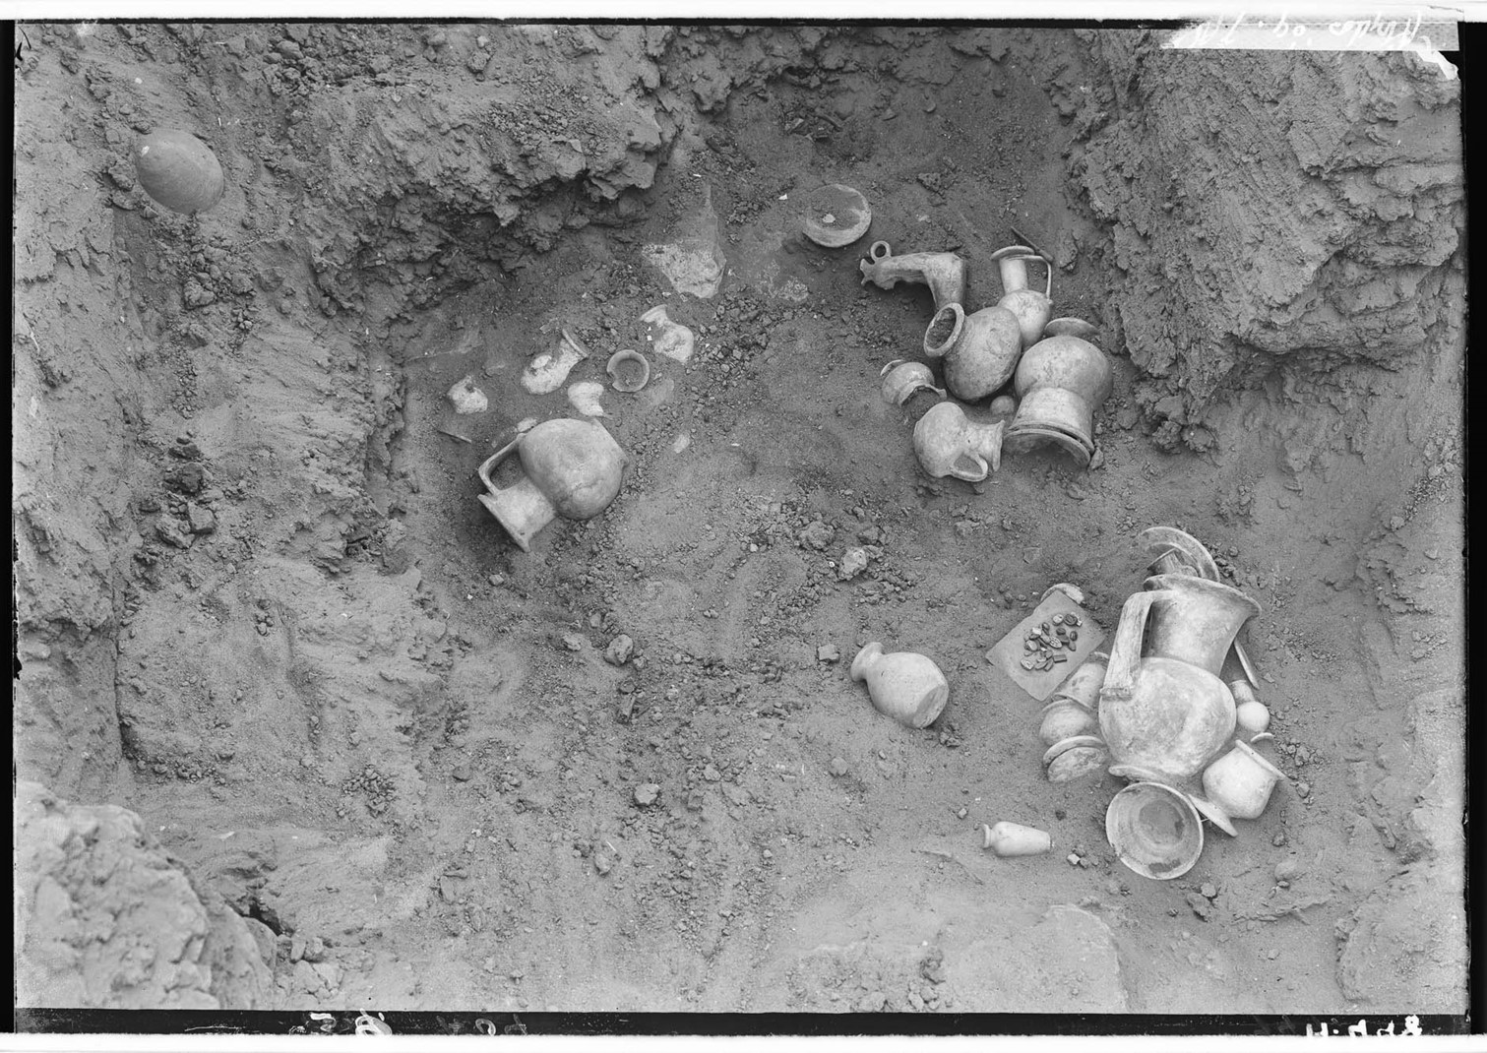
What is the function of the Kneeling women vessels from the 18th dynasty?
Kirsten Uyttersprot

Slide 2
Breastmilk as a medicine
Most commonly used for:
Burn wounds
Eye diseases
Other remedies
Information from:
Papyri
London Medical Papyrus (BM EA 10059) for burns
Each remedy requires milk from a woman who gave birth to a son
As a reference to Isis and her son Horus
Gives the milk a magical aspect
“To be placed on your body, that your vessels be sound. I cause the fire that assailed you to retreat. Words to be spoken over the aAgypt - parts of the acacia, bran, rhizomes of Cyperus esculentus, cooked, carob fruit (?), cooked, excrement, cooked, made into ⟨one⟩ mass, mixed with the milk of a woman who has given birth to a boy, and placed on the wound, to make it well. You are to tie it with a leaf of the rizinus plant”
Leitz, C. Magical and Medical Papyri of the New Kingdom. Hieratic Papyri in the British Museum 7 (London: British Museum press, 1999), 72.

Slide 3
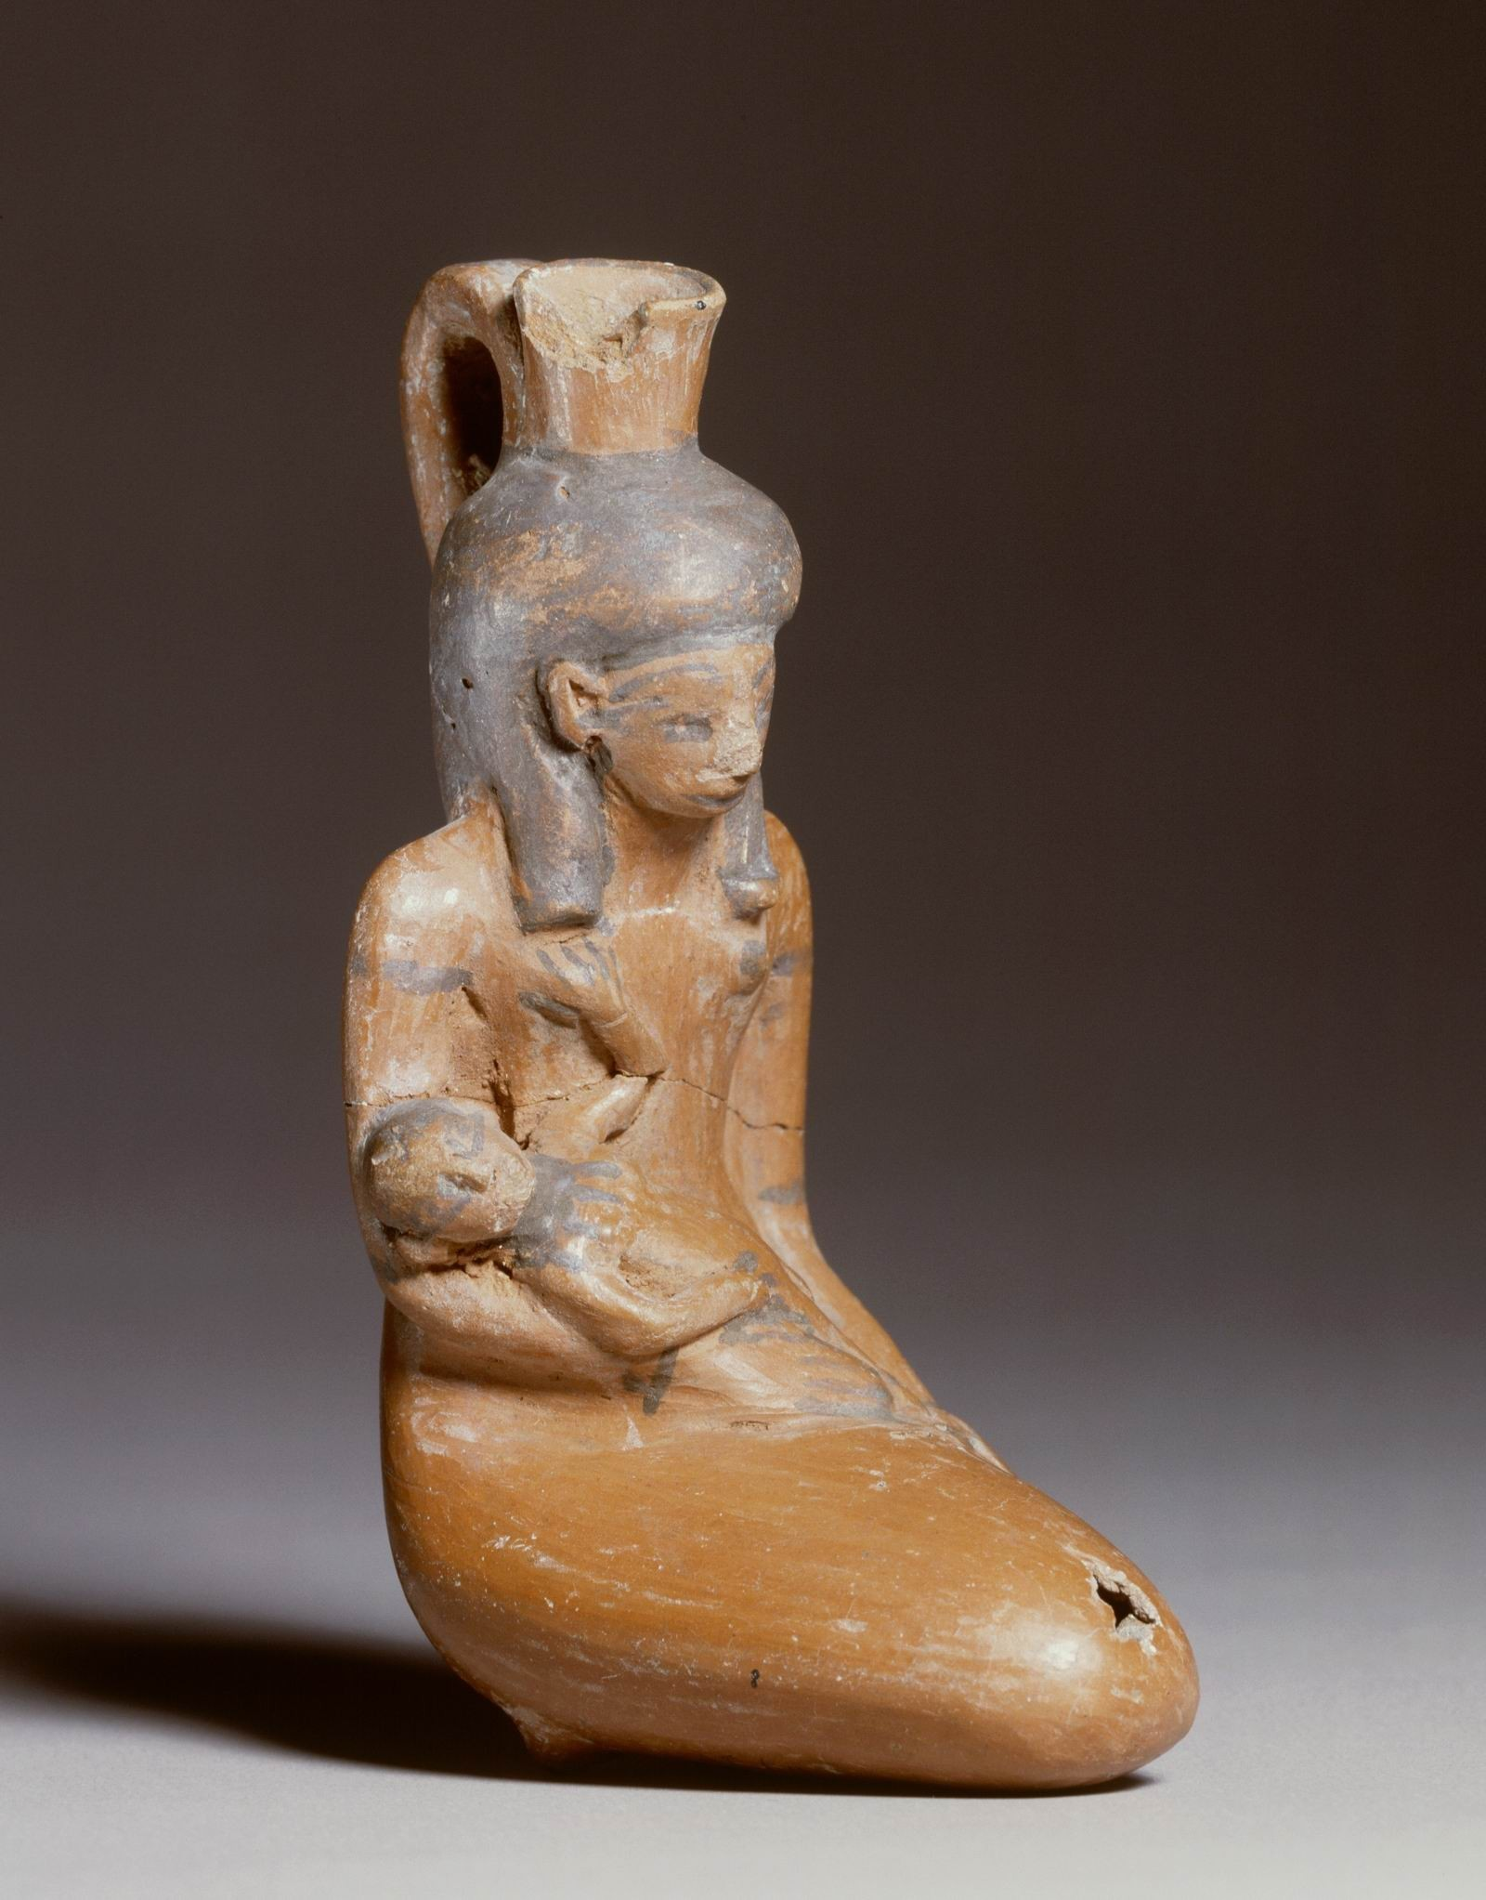
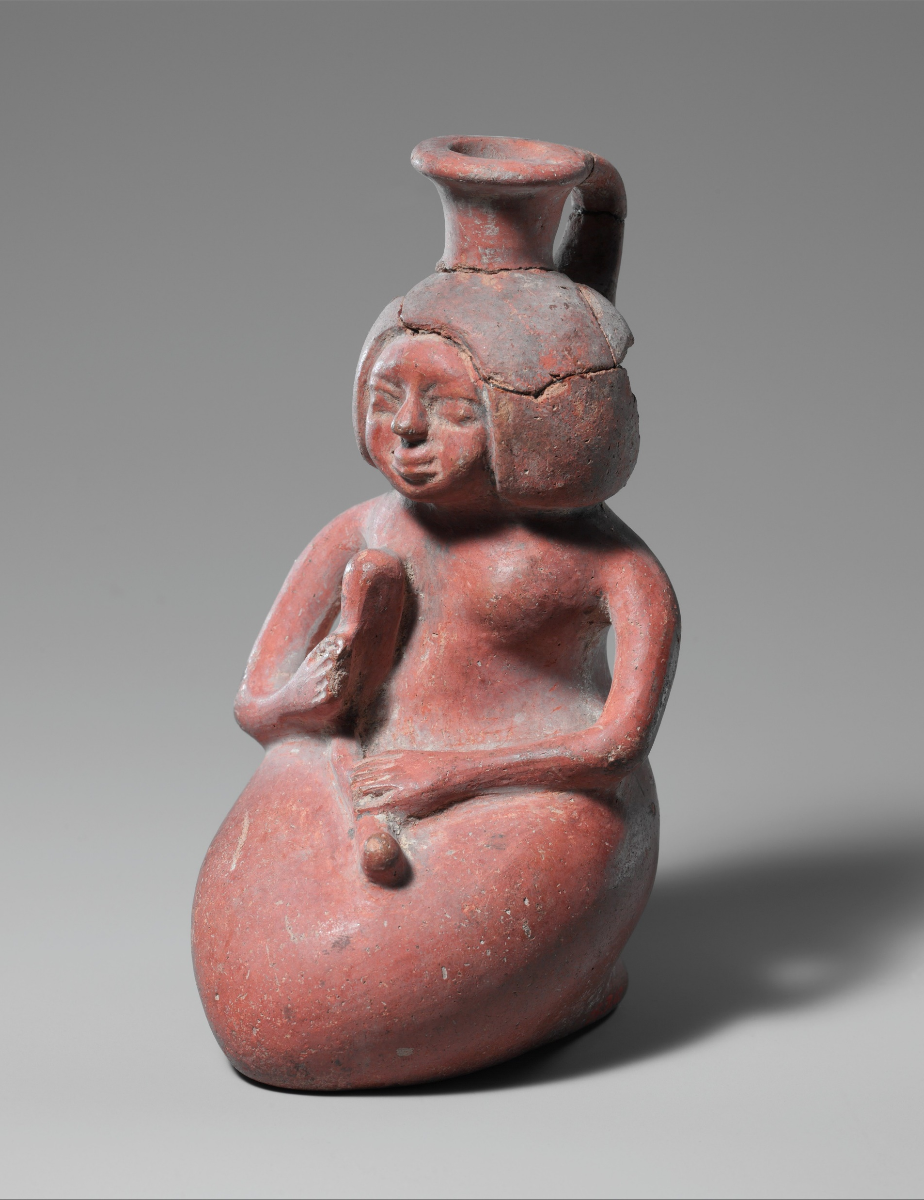
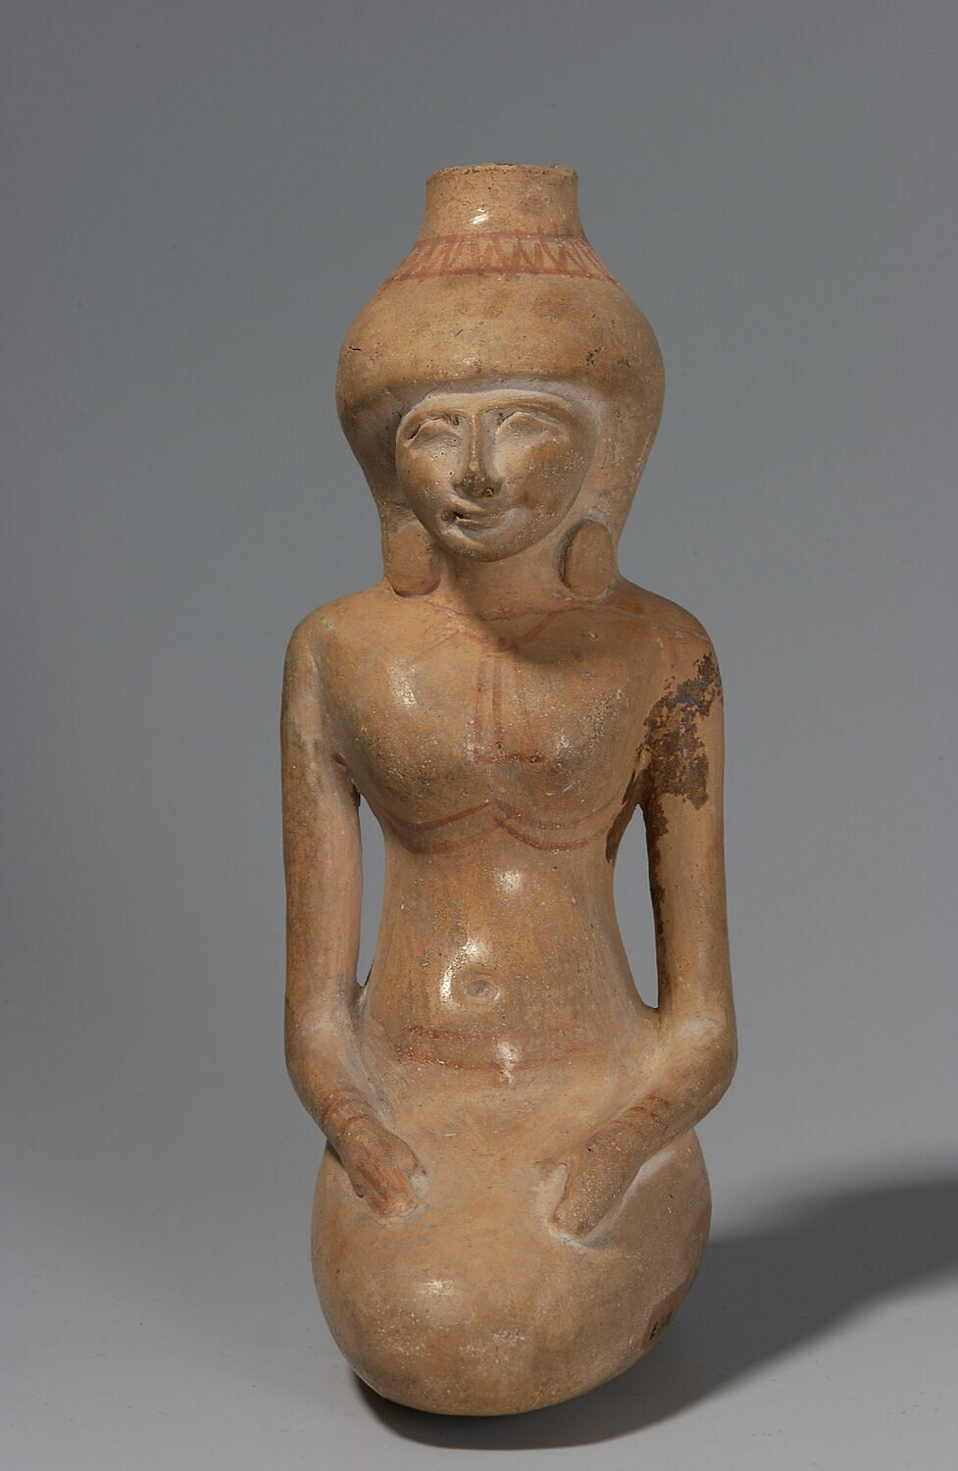
Different kinds of the kneeling woman vessels:
Woman with a child | Woman with a music instrument | Woman holding nothing | Mixed
AT 69
©RMO, Leiden.
25.7.42
© Metropolitan Museum of Art, New York.
E 14711
© Musée du Louvre, Dist. Grand Palais RMN, Christian Décamps.
EA 54694
©The Trustees of the British Museum

Slide 4
Complete vessels known today
Total: 20
Objectnumber: | Museum/ Collection: | Provenance: | Holding: | Height:
N 968 | Louvre |  | Child | 11,2 cm
N 969 | Louvre |  | Child | 16,6 cm
AM 14476 | Ägyptisches Museum, Berlin |  | Child | 13,0 cm
61.9 | Brooklyn Museum | Saqqara | Child | 11,3 cm
3632 | Moskow, museum unknown |  | Child | unknown
AT 69 | Rijksmuseum van Oudheden, Leiden |  | Child | 13,5 cm
1985336 | Museum of Fine Arts, Boston |  | Child | 14 cm
FGA-ARCH-EG-0634 | Fondation Gandur pour l’Art |  | Child | 12,7 cm
1159 | private collection, orginally from Sangiorgi collection untill 1948 |  | Child | 15 cm
Nos. 799,192 | unknown |  | Child | unknown
Unknown number | Plaisant Jozef Nestor collection |  | Child | 15,9 cm
EA 24652 | British Museum | Abydos | Child on back and horn | 13,2 cm
EA 54694 | British Museum | Abydos tomb 949 | Child on back and horn | 12,2 cm
E 11276 | Louvre |  | Horn | 12,4 cm
25.7.42 | The Metropolitan Museum | Saqqara | Music instrument (?) | 15,3 cm
EA 66711 | British Museum |  | Music instrument (?) | 12,8 cm
JE 39185-bis | Egyptiand museum, Caïro |  | Unknown object | 10 cm
E 14711 | Louvre |  | Nothing | 13,5 cm
EA 30724 | British Museum |  | Nothing | 15,6 cm
E 2432 | Ashmolean museum | Abydos tomb w 1 | Nothing | unknown

Slide 5
Fragments
Total: 6
Objectnumber: | Museum: | Provenance: | Holding:
37.335E | Brooklyn Museum | Saqqara | Child in arms
14434 | British Museum | Unknown | Child
E 2269 | Ashmolean museum | Abydos, Araba al-Madfuna | Unknown
AN 1921.1290 | Ashmolean museum | Sedment tomb 263 | Unknown
AN 1921.1291 e | Ashmolean museum | Sedment tomb 263 | Unknown
AN 1921.1291 f | Ashmolean museum | Sedment tomb 263 | Unknown
Based on what the figure is holding
Shape of the fragment

Slide 6
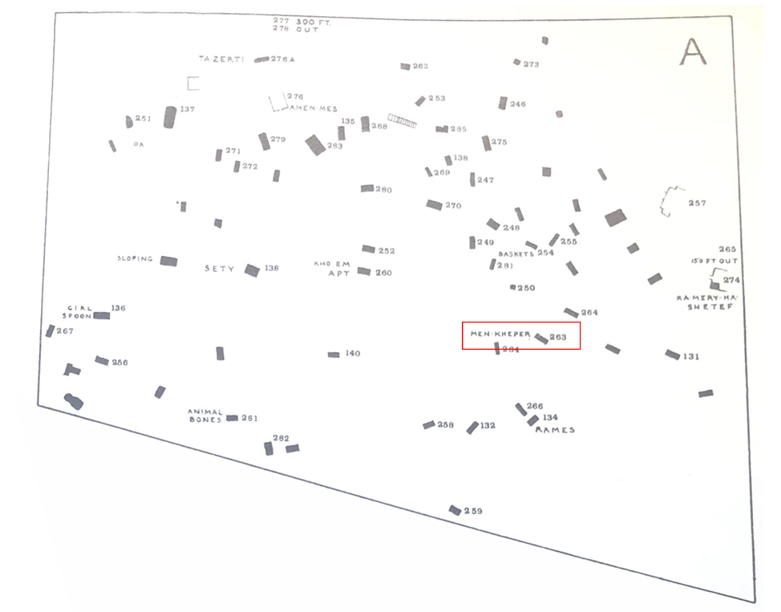
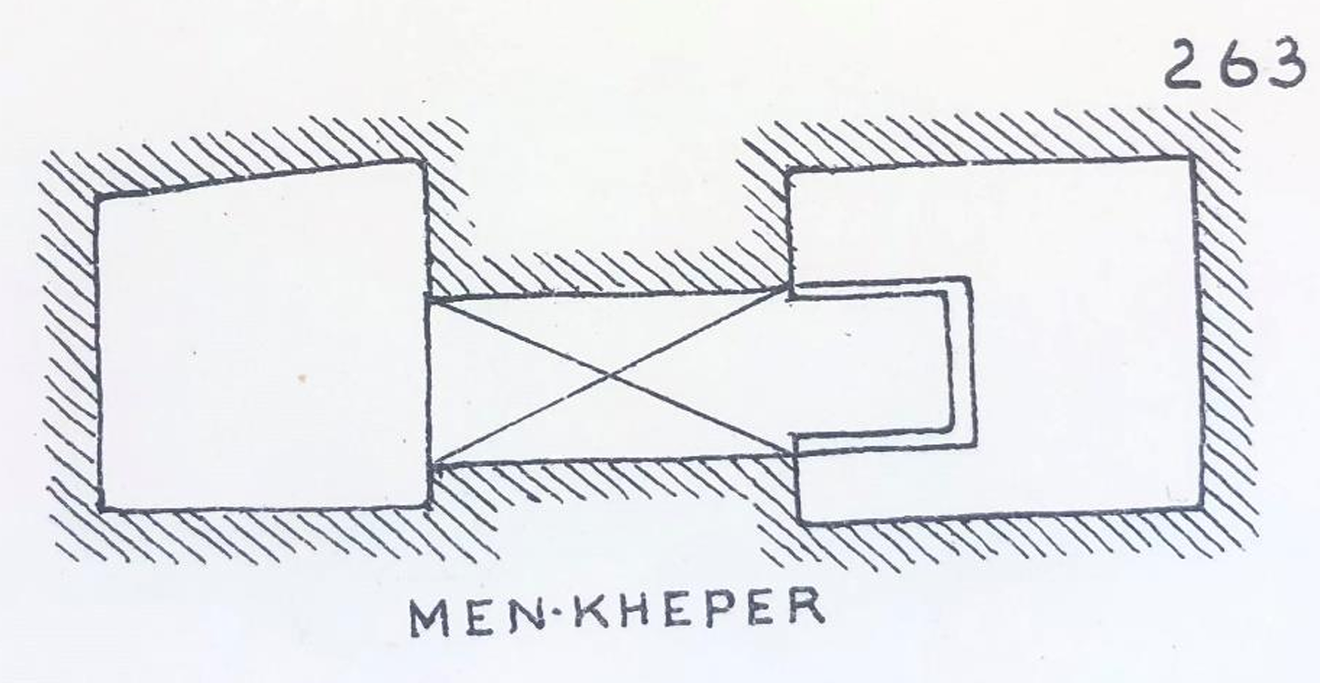
Provenance:
Not much known about the provenances
From the 26 objects only 10 provenances known and only 3 known in which tomb
Sites:
Saqqara : 3
Abydos : 4
1 from tomb 949
1 from tomb W1
Sedment : 3 fragments
3 from tomb 263
= tomb of Menkheper
Was a scribe

Slide 7
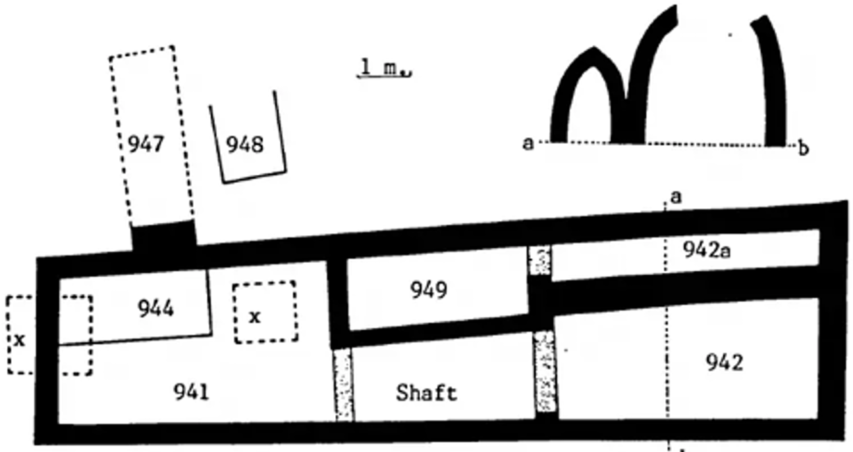
‘Main deposit’ as found by John Garstang, marked with an ‘X’ on the tomb plan of Tomb 949 in Abydos
EA54694 ©The Trustees of the British Museum

Slide 8
Function of the vessels
1. Container for milk?
Pro:
Content on average between 102 and 104 cc = production of milk from 1 breast
Contra:
Not a lot found of the vessels, it would be expected to find more examples then
The milk would spoil quickly when stored without putting the container in a cool place
The spout is not easy to drink from for a baby
2. Part of a “pharmacy”?
Pro:
The use of milk from a woman who gave birth to a son is a common mentioned medicine
The shape of the vessel can give an extra magical and healing meaning to the content of it
Contra:
Vessels were found in funerary contexts
Tombs from people who were not a doctor or had something to do with medicine

Slide 9
Who are the women?
3 categories:
Wet nurses
Women depicted with a child
Maid
Women without any objects
To serve/ help the person in the afterlife
Musician
Women with the suspected instrument
Function unclear
What if the object is a type of cloth used while breastfeeding?
BUT:
Categories based on only a couple known objects of the type of kneeling women vessels
Also vessels where a child is depicted with the woman are found in tombs
Such as EA54694 (Tomb 949)
The theory of a maid serving in the afterlife can be rejected
Only 10 provenances known,
= too little to make conclusions

Slide 10
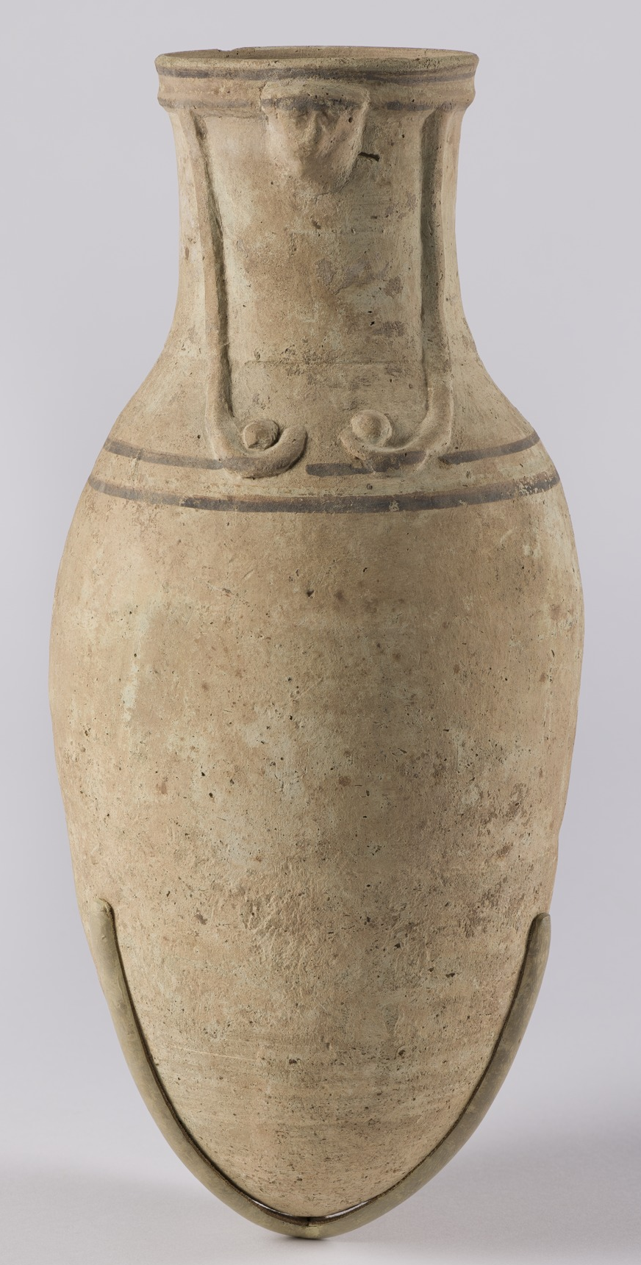
Conclusions:
Too little known about provenances to draw concrete conclusions
My suggestions:
To be seen as 1 group of objects
Different kinds of objects with the women
Does not directly indicate a different use
The known provenances all come from tombs
So maybe the objects should be seen in funerary practices
Position of the women can be compared to the mourning Isis and Nephthys figurines
Sitting with their legs tucked under them
Maybe as a replacement of the Hathor and Isis vessels used for milk libations in funerary practices that dissappear in the 18th Dynasty
The kneeling woman vessels are assigned to the 18th Dynasty
Mourning Nephthys
Metropolitan Museum of Art, New York (12.182.23a)
Hathor Vase
Brooklyn Museum, New York (14.642)
Conclusion:
The kneeling woman vessels have replaced the Hathor or Isis milk libation vases in the 18th dynasty

